Slide 1

TRƯỜNG CAO ĐẲNG LÝ TỰ TRỌNG TP. HỒ CHÍ MINH

Slide 2

KHOA KHOA HỌC CƠ BẢN

Slide 3

ỦY BAN NHÂN DÂN THÀNH PHỐ HỒ CHÍ MINH
TRƯỜNG CAO ĐẲNG LÝ TỰ TRỌNG TP. HỒ CHÍ MINH
Bậc đào tạo: TRUNG CẤP CHUYÊN NGHIỆP
Tên giảng viên: LÊ NGUYỄN MỸ TRÂM

Slide 4

good afternoon class 19t2

Slide 5

REVIEW 
CHOOSE THE CORRECT WORD:
1. The bird sang ______________ (its/ it/ it’s) happy tune.
☞ its

Slide 6
2. Listen to ______________ (her/ hers/ her’s) carefully.
☞ her
3. (His/ He/ She) ______________ uncle is a doctor. He is a nice person.
➔ His

Slide 7
4. That old man is kind to ______________ (our/ us/ we).
☞ us
5. William and Tracy love ______________ (their/ theirs/ they) dogs so much.
➔ their

Slide 8
6. The teacher told ______________ (us/ our/ we) an interesting story.
➔ us
7. I want to sit between you and ______________ (he/ him/ his).
☞ him

Slide 9
8. She has an apple in ______________ (she/ her/ hers) hand.
☞ her
9. Bob and Ted live near ______________ (them/ their/ they) school.
➔ their

Slide 10

Complete the sentences using the simple past of the verbs in parentheses.
1. Maria ___________ to the cinema last night. (go)
☞ went

Slide 11
2. I and my friends ___________ a great time in Tokyo last year. (have)
 had
3. My vacation in Hue last summer ___________ wonderful. (be)
 was

Slide 12
4. My parents ___________ very tired after the trip to Tokyo last year. (be)
 were
5. I ___________ a lot of gifts for my little sister last vacation. (buy)
 bought

Slide 13
6. Lan and Mai ______________ sharks, dolphins and turtles at Tri Nguyen aquarium last summer. (see)
 saw
7. Yesterday, John ___________ chicken and rice for dinner. (eat)
 ate

Slide 14
8. Yesterday, I (go) ___________ to the restaurant with a client.
 went
9. Last summer, we (drive) ___________ to Nha Trang.
 drove

Slide 15
10. A moment ago, the students stopped in the grocery store and (buy) ___________ some sandwiches.
 bought
11. It was warm, so I _____________ off my coat. (take)
 took

Slide 16
12. The film wasn't very good. I ____________________ it very much. (enjoy)
 didn’t enjoy
13. I knew Sarah was very busy, so I ___________________ her. (disturb)
 didn’t disturb

Slide 17
14. It was hard work carrying the bags. They ________________ very heavy. (be)
 were
15. The bed was very uncomfortable. I _________________ very well. (sleep)
 didn’t sleep

Slide 18
16. Sue wasn't hungry, so she _________________ anything. (eat)
 didn’t eat
17. We went to Kate's house but she __________________ at home. (be)
 wasn’t

Slide 19
18. It was a funny situation but nobody ____________________ . (laugh)
 laughed
19. The window was open and a bird ____________________ into the room. (fly)
 flew

Slide 20
20. The hotel wasn't very expensive. It ____________________ very much. (cost)
 didn’t cost
21. I was in a hurry, so I ____________________ time to phone you. (have)
 had

Slide 21

The end of the review
GOOD LUCK TO YOU!

Slide 22
 ONE - PERIOD TEST 
1. Peter visits _________ grandparents every weekends.
a. her
b. his
c. their
d. our

Slide 23
2. We begin _________ work at noon every day.
her
his
their
our

Slide 24
3. They take _________ children to school every morning.
a. her
b. his
c. their
d. our

Slide 25
4. I have a lovely grey cat. _________ teeth are very sharp.
a. Its
b. His
c. Their
d. Our

Slide 26
5. They are the smartest kids here. _________ house is near the city.
a. His
b. Her
c. Their
d. Our

Slide 27
6. He _________ some flowers for his mother yesterday.
a. is buying
b. buys
c. bought
d. has bought

Slide 28
7. As soon as it saw us, the bird _________ away.
a. flies
b. flew
c. flying
d. has flown

Slide 29
8. I _________ late on Sunday morning.
a. sleeps
b. sleeping
c. slept
d. was sleeping

Slide 30
9. A moment ago I offered him a biscuit and he _________ the whole plateful.
a. eats
b. eaten
c. is eating
d. ate

Slide 31
10. We saw their car outside the house and _________ away.
a. drive
b. drove
c. are driving
d. were drove

Slide 32
11. The food _________ already on the table.
a. were
b. was
c. has been
d. is

Slide 33
12. I _________ him this morning.
a. saw
b. to see
c. seen
d. see

Slide 34
13. Here's your pen - I _________ it by mistake.
a. went
b. bought
c. wrote
d. took

Slide 35
14. My mother ________ to give me details about the birthday party.
a. went
b. bought
c. wrote
d. took

Slide 36
15. Last year, I _________ my car to him for $600.
a. sell
b. sold
c. has sold
d. sells

Slide 37
16. Liz and Phil have a ___________ and three sons.
a. aunt
b. sister
c. daughter
d. niece

Slide 38
17. My brother's wife and I both had babies around the same time, so the ___________ are very close in age.
a. children
b. nephew
c. cousins
d. nieces

Slide 39
18. A ___________ is a daughter of your brother or sister, or a daughter of your husband's or wife's brother or sister.
a. aunt
b. sister
c. daughter
d. niece

Slide 40
19 . A ___________ is a son of your sister or brother, or a son of the sister or brother of your husband or wife.
a. nephew
b. niece
c. cousin
d. uncle

Slide 41
20. We got ___________ with friends on Saturday nights.
a. into
b. around
c. together
d. inside

Slide 42
21. They believe that Europe needs a common foreign and security ___________.
a. payment
b. policy
c. employer
d. vacation

Slide 43
22. He gets paid a good wage, because he works for a fair ___________.
a. requirement
b. policy
c. employer
d. employee

Slide 44
23. European Airlines ___________ its customers top-quality service.
a. guarantees
b. requires
c. pays
d. performs

Slide 45
24 . He's ___________ at the moment - can I get him to call you back?
a. on
b. off
c. about
d. in

Slide 46
25. The ___________ is spending millions of dollars in its attempt to combat drug abuse.
a. policy
b. employer
c. government
d. requirement

Slide 47
The end of the TEST.
GOODBYE EVERYBODY!
See you next time!
Have a nice weekend!

Slide 48

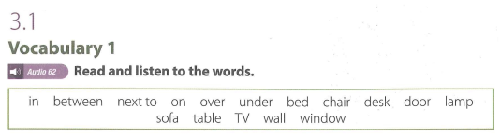
UNIT 3: LOCATIONS

Slide 49
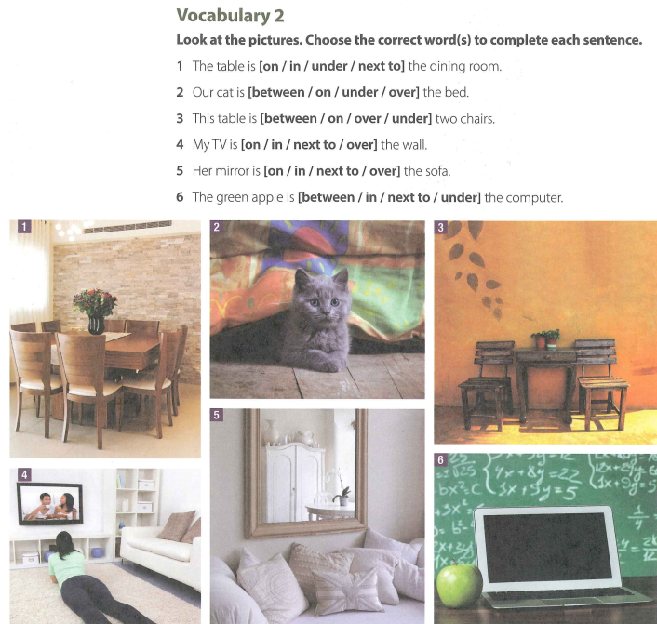

Slide 50
VOCABULARY 2 (KEY)
  The table is [on / in / under / next to] the dining room.
  Our cat is [between / on / under / over] the bed.
  This table is [between / on / over / under] two chairs.
  My TV is [on / in / next to / over] the wall.
  Her mirror is [on / in / next to / over] the sofa.
  The green apple is [between / in / next to / under] the computer.

Slide 51
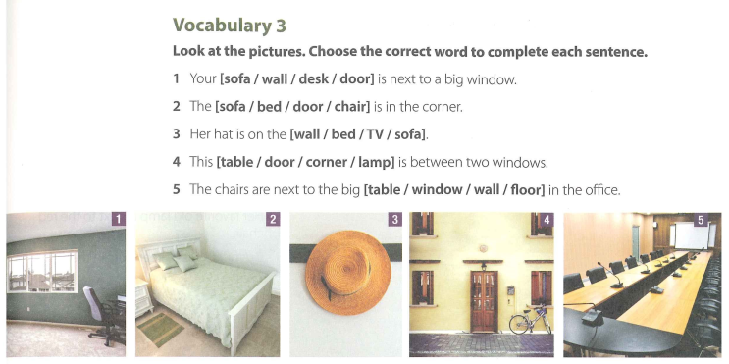

Slide 52
VOCABULARY 3 (KEY)
Your [sofa / wall / desk / door] is next to a big window.
The [sofa / bed / door / chair] is in the corner.
Her hat is on the [wall / bed / TV / sofa].
This [table / door / corner / lamp] is between two windows.
The chairs are next to the big [table / window / wall / floor] in the office.

Slide 53
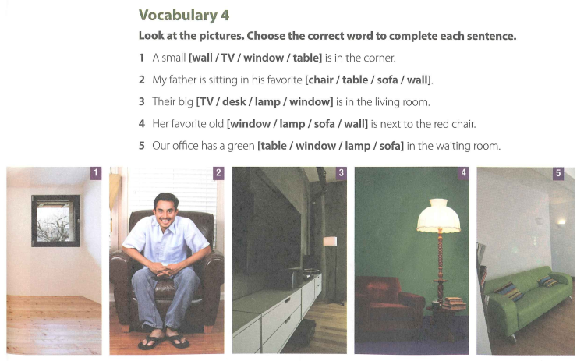

Slide 54
VOCABULARY 4 (KEY)
A small [wall / TV / window / table] is in the corner.
My father is sitting in his favorite [chair / table / sofa / wall].
Their big [TV / desk / lamp / window] is in the wing room.
Her favorite old [window / lamp / sofa / wall] is next to the red chair.
Our office has a green [table / window / lamp / sofa] in the waiting room.

Slide 55
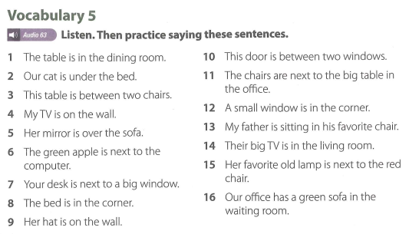

Slide 56
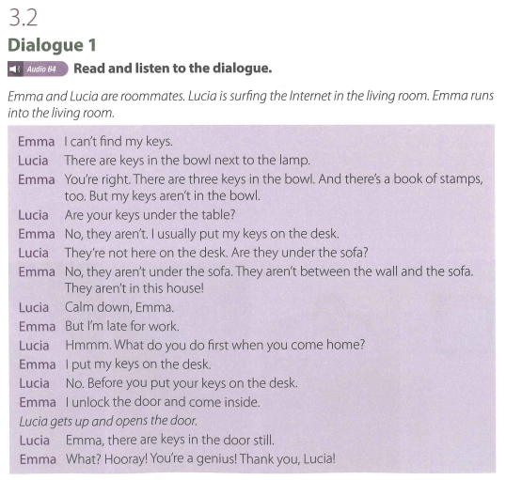

Slide 57
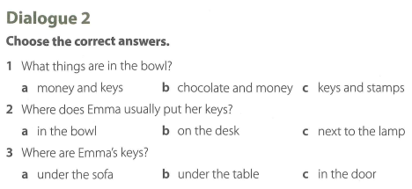

Slide 58
Dialogue 2 (Key)
1. What things are in the bowl?
a money and keys
b chocolate and money
c keys and stamps
2. Where does Emma usually put her keys?
a in the bowl b on the desk
c next to the lamp
3. Where are Emma’s keys?
a under the sofa
b under the table c in the door

Slide 59

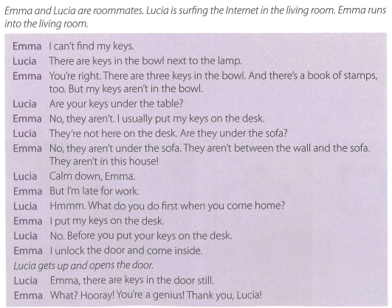

Slide 60
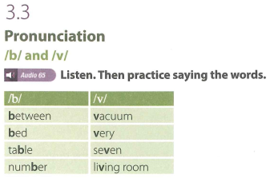

Slide 61
Thank you very much
for
your cooperation.

